Slide 1
C# Professional Level 1
Collections

Slide 2
Chapter Agenda
Collections, why?
Namespace
Generic Type
List
Foreach
Dictionary
Stack vs Queue
Choosing a collection

Slide 3
Collections, why?
Managing group related objects
More flexible than an array
Can grow and shrink dynamically
Some collections can use a key-value pair system
Notes:
For many applications, you want to create and manage groups of related objects. There are two ways to group objects: by creating arrays of objects, and by creating collections of objects.
Arrays are most useful for creating and working with a fixed number of strongly-typed objects.
Collections provide a more flexible way to work with groups of objects. Unlike arrays, the group of objects you work with can grow and shrink dynamically as the needs of the application change. For some collections, you can assign a key to any object that you put into the collection so that you can quickly retrieve the object by using the key.

Slide 4
Namespace
Choose your collection class carefully
A wrong type can restrict your use of collection
Avoid using types in the System.Collections namespace
Generic and concurrent versions of collections are to be preferred
Greater safety
Other improvements
You can use classes in the System.Collections.Generic namespace
A generic collection enforces the type safety
No other data type can be added to it
Retrieved data from a generic collection does not need to have its type determined or to be converted
Notes:
Be sure to choose your collection class carefully. Using the wrong type can restrict your use of the collection. In general, avoid using the types in the System.Collections namespace.
The generic and concurrent versions of the collections are to be preferred because of their greater type safety and other improvements. You can use one of the classes in the System.Collections.Generic namespace.
A generic collection enforces type safety so that no other data type can be added to it. When you retrieve an element from a generic collection, you do not have to determine its data type or convert it.

Slide 5
Standard Collection

Slide 6
Standard
Collection types represent different ways of collecting data, such as hash tables, queues, stacks, bags, dictionaries and lists.
In collections based on IList or directly on ICollection, each element contains only one value. These types are the following:
Array
ArrayList
Queue
Stack
In interface-based collections, each element contains both a key and a value at IDictionary. These types are the following:
Hashtable
SortedList

Slide 7

Generic Type
Cup<T>
Use it, like it

Slide 8
Generics – Overview
Use generic types to :
maximize code reuse
type safety
performance
The most common use of generics is to create collection classes.
You can create your own generic interfaces, classes, methods, events and delegates.
Generic classes may be constrained to enable access to methods on particular data types.
Information on the types that are used in a generic data type may be obtained at run-time by using reflection.

Slide 9
Generic – Quick Sample
For example, by using a generic type parameter T you can write a single class that other client code can use without incurring the cost or risk of runtime casts or boxing operations, as shown here:
// Declare the generic class. public class GenericList<T> { void Add(T input) { } }
class TestGenericList { private class ExampleClass { } static void Main() { // Declare a list of type int. GenericList<int> list1 = new GenericList<int>(); // Declare a list of type string. GenericList<string> list2 = new GenericList<string>(); // Declare a list of type ExampleClass. GenericList<ExampleClass> list3 = new GenericList<ExampleClass>(); } }

Slide 10
When to use generic collections ?
Using generic collections gives you the automatic benefit of type safety without having to derive from a base collection type and implement type-specific members. Generic collection types generally work better than corresponding non-generic collection types (and better than types derived from nongeneric base collection types) when the collection elements are value types, because with generics, there is no need to box the elements.

Slide 11

var oList = new List<T>()

Slide 12
List<T>
A list is at first glance similar to an array: It stores objects of a given type. There are, however, significant differences between the two.
First, the size of a table is fixed while the size of a list is variable:
You can add or remove items whenever you want.
In addition, once a table is created, you have "fixed" boxes; In a list, the order of the elements can be changed as you want.

Slide 13

Iterate collections
foreach(var ... in …){ /* */}

Slide 14
foreach
The foreach keyword is used to iterate through objects that implement the IEnumerable interface.
Syntax :
foreach (string firstName in firstNameList)
{
Console.WriteLine(firstName);
}
As in a For loop, you can use break; To exit the loop or continue; To move to the next item.

Slide 15
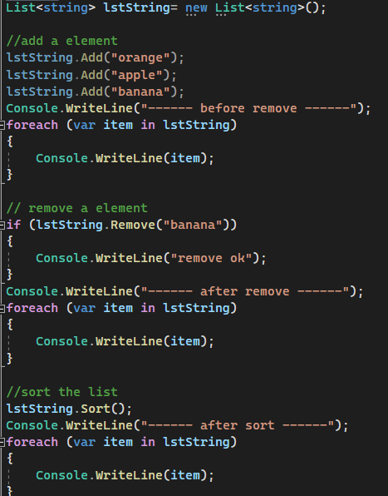
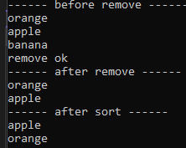
List<T>

Slide 16

var oDic = new Dictionary<TKey, TValue>()

Slide 17
Dictionary<TKey, TValue>
The Dictionary<TKey, TValue> class is located in the System.Collections.Generic namespace.
A dictionary is a collection of key/value pairs, each key being unique.
It is a generic class: It is necessary to specify the type of the keys and the type of the values.
If you won’t use generic, you can use Hashtable class from the System.Collections namespace :
Represents a collection of key/value pairs that are organized based on the hash code of the key.

Slide 18
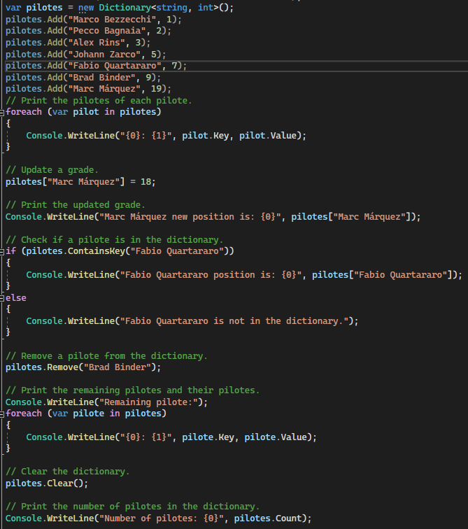

Dictionary<TKey, Tvalue>

Slide 19

Stack & Queue
LIFO & FIFO

Slide 20
Stack<T> Queue<T>
Represents a last-in-first-out (LIFO) collection of objects.
Represents a first-in, first-out (FIFO) collection of objects.
Queues and stacks are useful when you need temporary storage for information; that is, when you might want to discard an element after retrieving its value.
Use Queue if you need to access the information in the same order that it is stored in the collection.
Use Stack if you need to access the information in reverse order.
Use ConcurrentQueue<T> or ConcurrentStack<T> if you need to access the collection from multiple threads concurrently.

Slide 21

Choosing a collection

Slide 22
Choosing a collection
I want to… | Generic collection options | Non-generic collection options | Thread-safe or immutable collection options
Store items as key/value pairs for quick look-up by key | Dictionary<TKey,TValue> | Hashtable (A collection of key/value pairs that are organize based on the hash code of the key.) | ConcurrentDictionary<TKey,TValue> ReadOnlyDictionary<TKey,TValue> ImmutableDictionary<TKey,TValue>
Access items by index | List<T> | Array ArrayList | ImmutableList<T> ImmutableArray
Use items first-in-first-out (FIFO) | Queue<T> | Queue | ConcurrentQueue<T> ImmutableQueue<T>
Use data Last-In-First-Out (LIFO) | Stack<T> | Stack | ConcurrentStack<T> ImmutableStack<T>
Access items sequentially | LinkedList<T> | No recommendation | No recommendation
Receive notifications when items are removed or added to the collection. (implements INotifyPropertyChanged and INotifyCollectionChanged) | ObservableCollection<T> | No recommendation | No recommendation
A sorted collection | SortedList<TKey,TValue> | SortedList | ImmutableSortedDictionary<TKey,TValue> ImmutableSortedSet<T>
A set for mathematical functions | HashSet<T> SortedSet<T> | No recommendation | ImmutableHashSet<T> ImmutableSortedSet<T>

